Slide 1

Mark Payne/ Vanessa Westley Ryan Lugalia-Hollon
Chicago Police Department YMCA of Metropolitan Chicago

Slide 2
Presentation Overview
Roles
Outcomes
Lessons Learned
Next Steps

Slide 3
Roles:
CAPS Revitalization
Developing a new standard for community policing within the department
Building respect and understanding for authentic relationship building
Creating a model where community engagement and law enforcement are balanced, working in harmony
YSVP – YMCA
Intensive mentoring for youth with high levels of trauma exposure
Approach built on the social ecological model, which requires the shifting of young people’s environment

Slide 4
Outcomes:
Capacity building through…
Training on effective interactions
  90+ Police Officers trained in DMC, and creative dialogue methods like Cafes and Circles
Creative community engagement
  40+ youth engaged in Circle and Café with police officers
  200+ Submissions to the ‘Strength and Beauty’ Photo Contest
  Ongoing District Level Cafes
Curriculum development
  Youth skill building through audio production
  Development of toolkit for adaptive use

Slide 5
Outcome: Training
Effective Youth-Police Interactions -- 40 CPD Participants .
CAPS Revitalization, SROs.
Cafe Training – 25 CPD Participants.
CAPS Revitalization.
Circle Training – 22 CPD Participants.
CAPS Revitalization.
MBSR – 20+ CPD Participants.
CAPS Revitalization / Crisis Intervention.
Crossroads – Institutional Racism.
Crisis Intervention.

Slide 6
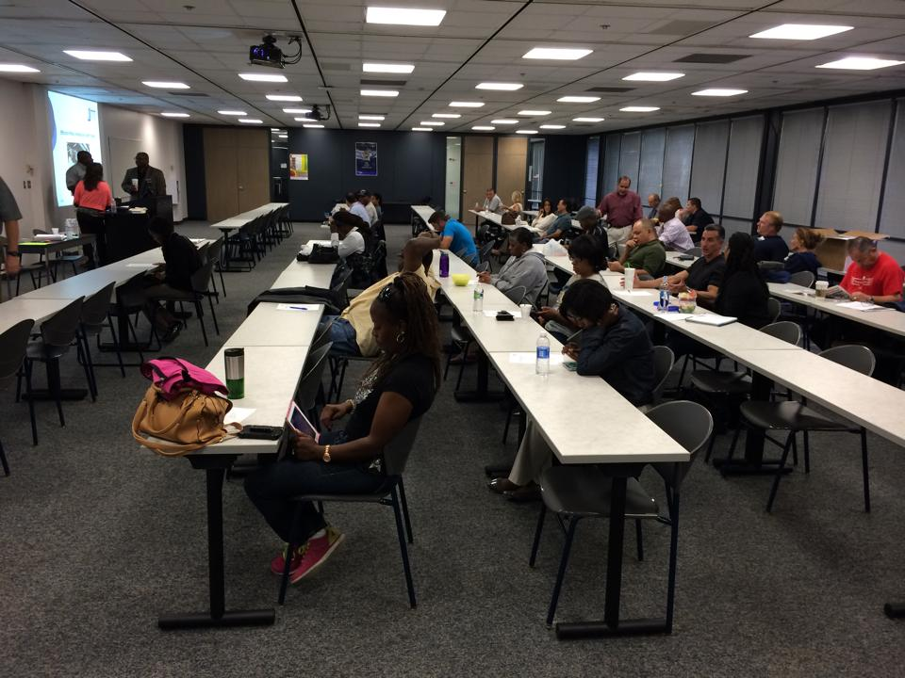

Slide 7
Outcome: Creative Community Engagement
Photo Contest in 3 Districts
Youth-Police Circle and Café in District 10
Community Café Pilots in District 4

Slide 8
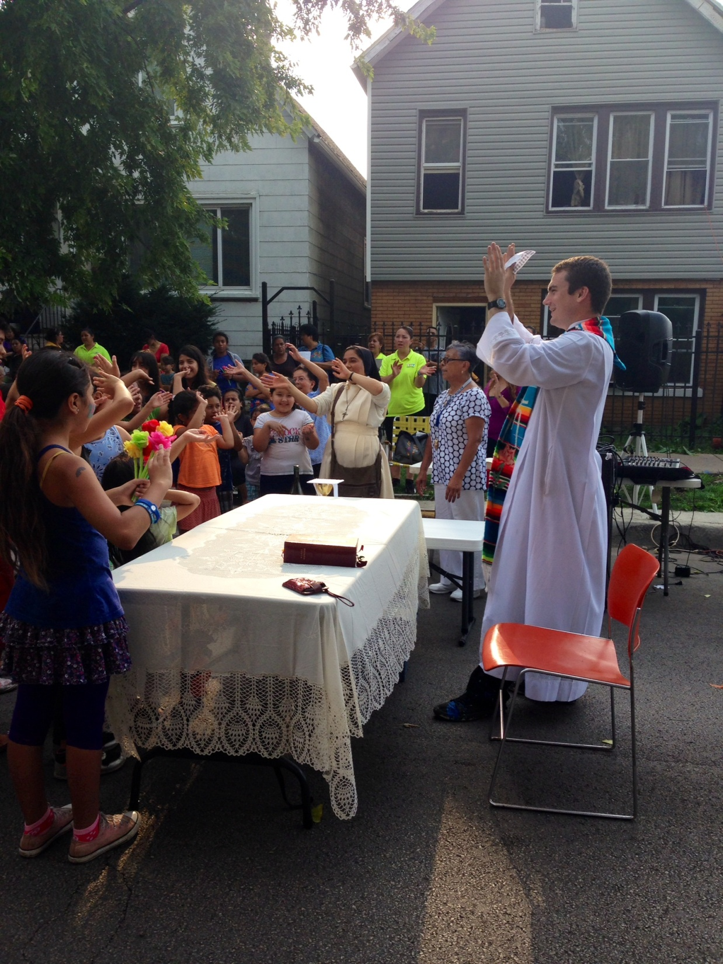
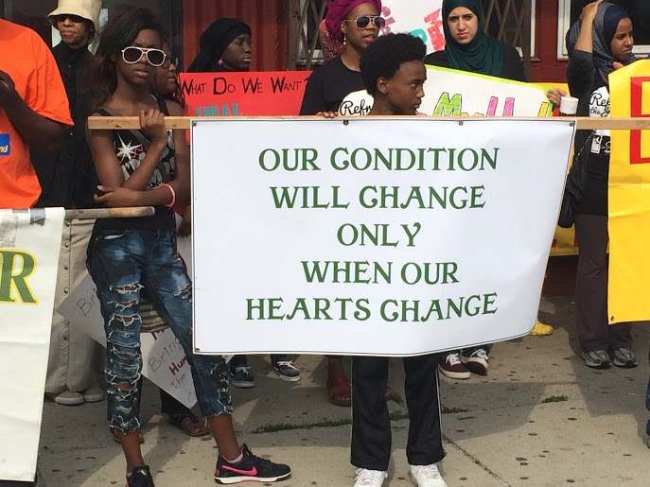

Slide 9
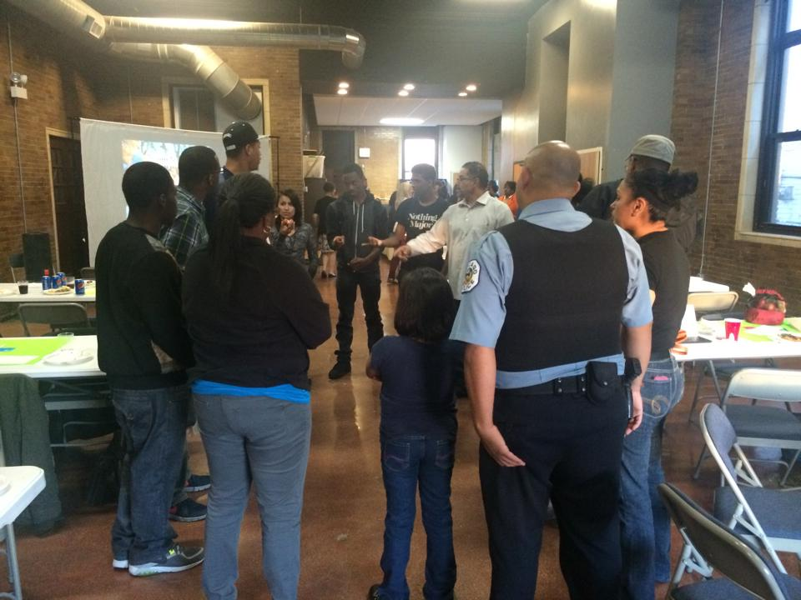

Slide 10
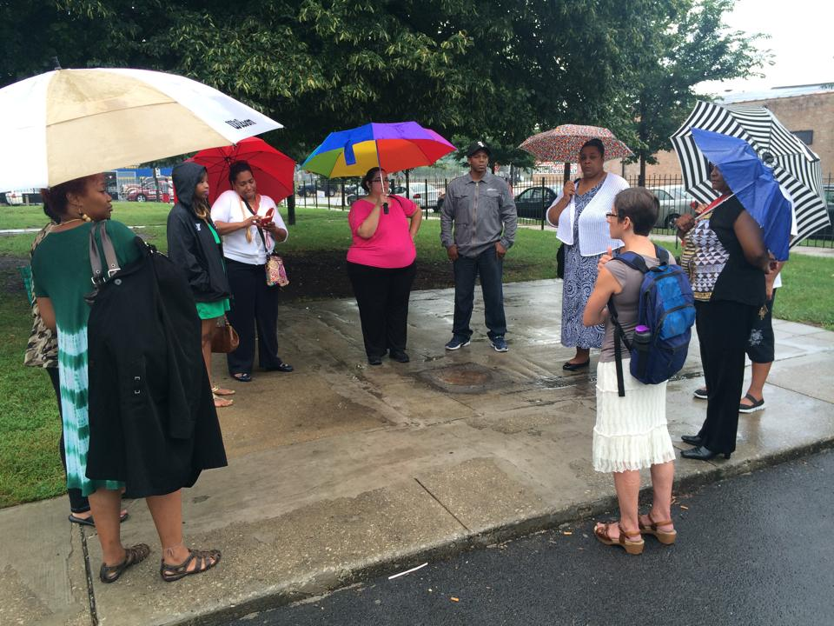

Slide 11
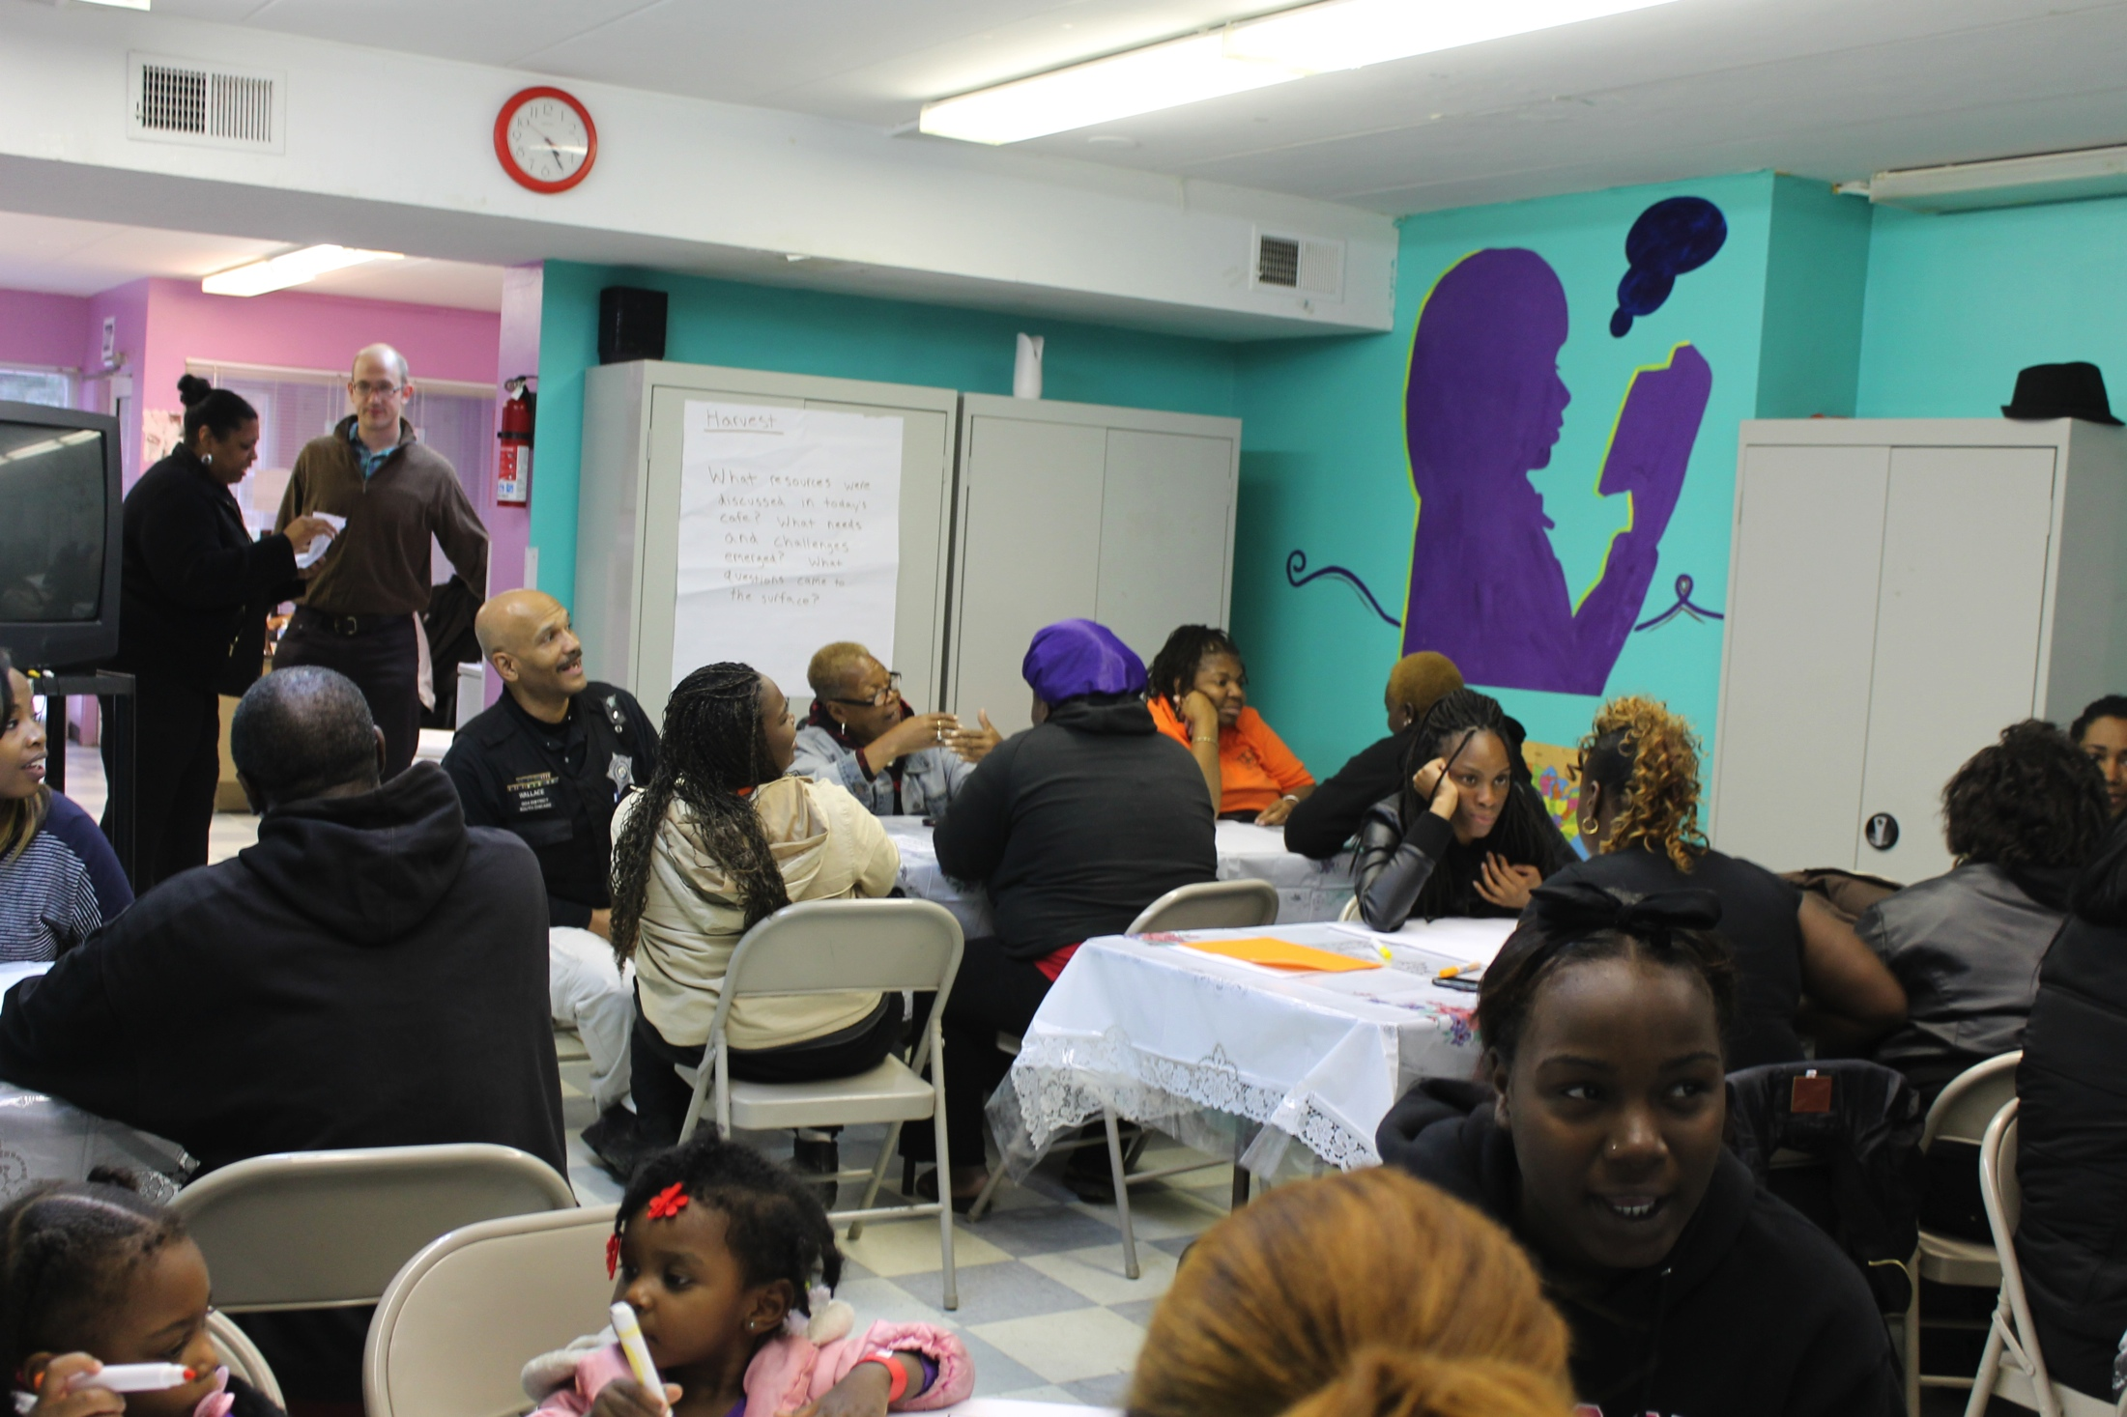

Slide 12
Outcome: Curriculum Development
A story album featuring the voices of both Chicago youth and Chicago Police Officers
A question deck that offers a flexible curriculum for youth-police conversations
A poster series that helps expand basic ideas about community safety

Slide 13
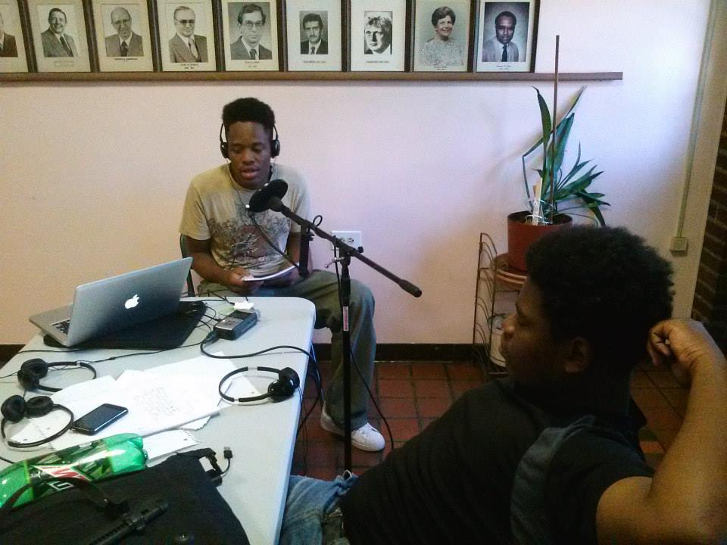

Slide 14
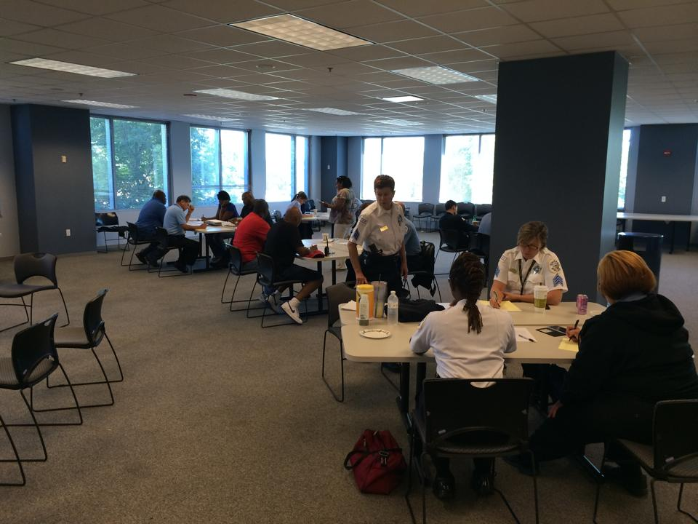

Slide 15
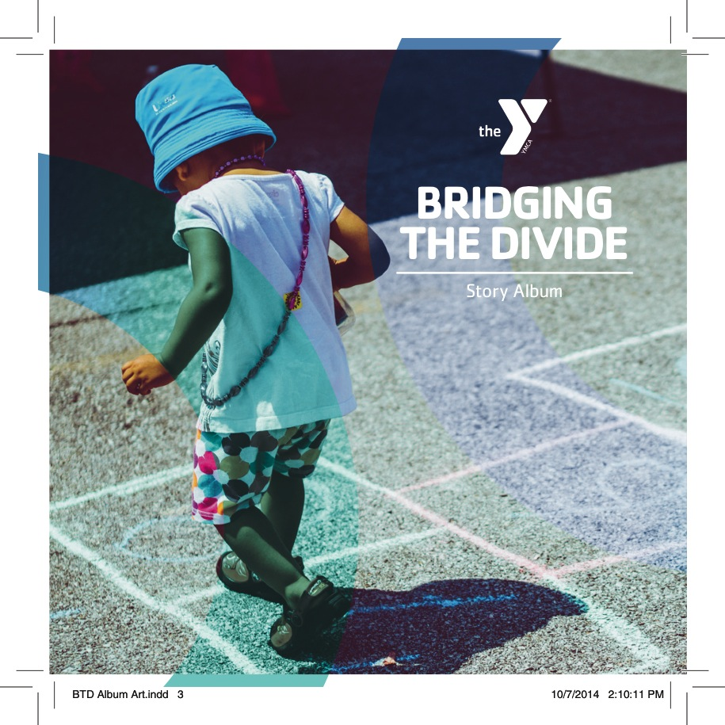

Slide 16
Lessons Learned:
Essential to secure CPD buy-in at both Headquarters and the District Level
Culture and receptivity varies significantly across police districts
A model for multi-stakeholder collaboration is key to sustainable success
Shifting police practice and community attitudes should be built into the structure of regular operations

Slide 17
Next Steps:
Distribute toolkit to City-wide CBO’s, Statewide partners
and National bodies (New Haven, Charleston, DOJ, Y-
USA).
Advance a restorative Beat Meeting model. Should
include dual facilitation with community partners who have
diversion and/or volunteer management capacity.
Must be connected to alternative measurements for
success, such as resources provided, hours volunteered, connections made.
Collective goal: Reduce arrests and shift incident handling.

Slide 18
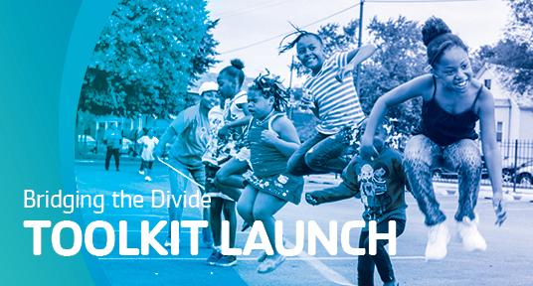
Monday, November 17, 6-8 pm
1608 W. 21st Place
Youth Safety and Violence Prevention, YMCA

Slide 19
